Slide 1

Learn CSS
Lesson 3
Colors in CSS
For more information visit
https://bptechnical2020.blogspot.com/

Slide 2
Contents
How to Specify Colors in CSS?
Implementing CSS in webpages
Inline CSS.
Internal CSS.
External CSS
Selectors in CSS.
Comments in CSS.

Slide 3
How to Specify Colors in CSS?
We can specify colors in CSS in 6 different ways, they are
Predefined color names
RGB
RGBA
HEX
HSL
HSLA

Slide 4
Predefined color names.
In CSS we can use the color names to specify color. For example we can use red, green, blue, white, yellow, pink. You can get the list of colors in the web. Modern browsers supports 140 color names.
https://htmlcolorcodes.com/color-names/
P
{
Color:red;
Background-color:green;
}

Slide 5
rgb (red,green,blue)
rgb(red,green,blue)
The value of each colors should be between 0-255. For example
rgb(0,0,0) all have 0 values and the color is black.
rgb(255,255,255) all have 255 values and the color is white.
rgb(255,0,0) only red have 255 values and blue and green is zero. The color is red.
rgb(0,255,0) only green have 255 values and blue and red is zero. The color is green.
rgb(100,255,150) only green have 255 values and blue is 150 and red is 100. This combination will create a new color. You can change the values and see the color.

Slide 6
rgba (red,green,blue,alpha)
The rgba() function define colors using the Red-green-blue-alpha (RGBA) model.
rgba is similar to rgb function. The rgba functions uses a additional parameter alpha whose value is from 0.0 to 1.0. If you give the alpha value 0.0 then it becomes fully transparent. You can see the background image if you use rgba function with the alpha value less than 1.0.

Slide 7
HEX
#rrggbb
rr is red, gg is green and bb is blue. hexadecimal integers specify the components of the color. The value we can enter is 00 to ff which is similar to 0 to 255.
#000000 is black, #ffffff is white, #ff0000 is red, #00ff00 is green. And we can create different colors by changing the values.
Note there is no HEXA in CSS. If you have to use the alpha then you shoud go for rgba.

Slide 8
HSL
hsl(hue, saturation, lightness)
Hue is a degree on the color wheel from 0 to 360. 0 is red, 120 is green, and 240 is blue.
Saturation is a percentage value, 0% means a shade of gray, and 100% is the full color.
Lightness is also a percentage, 0% is black, 50% is neither light or dark, 100% is white
RED:hsl(0,100%,50%)
GREEN:hsl(120,100%,50%)
BLUE:hsl(240,100%,50%)

Slide 9
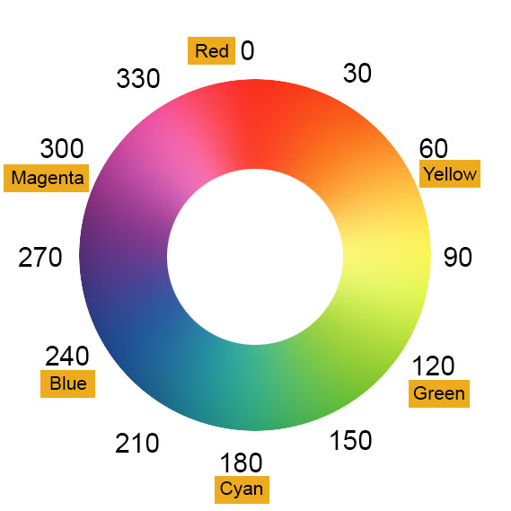
HSL Wheel

Slide 10
HSLA
hsl(hue, saturation, lightness, alpha)
alpha parameter is a number between 0.0 (fully transparent( and 1.0(not transparent at all)
RED:hsl(0,100%,50%, 0.5)

Slide 11
Thank you for watching!
If you like this video please share and subscribe. Please comment your suggestions.

